Slide 1
LA Cities Home Buyer Guide
USC DataBootcamp First Project
Group : PyitUp

Slide 2
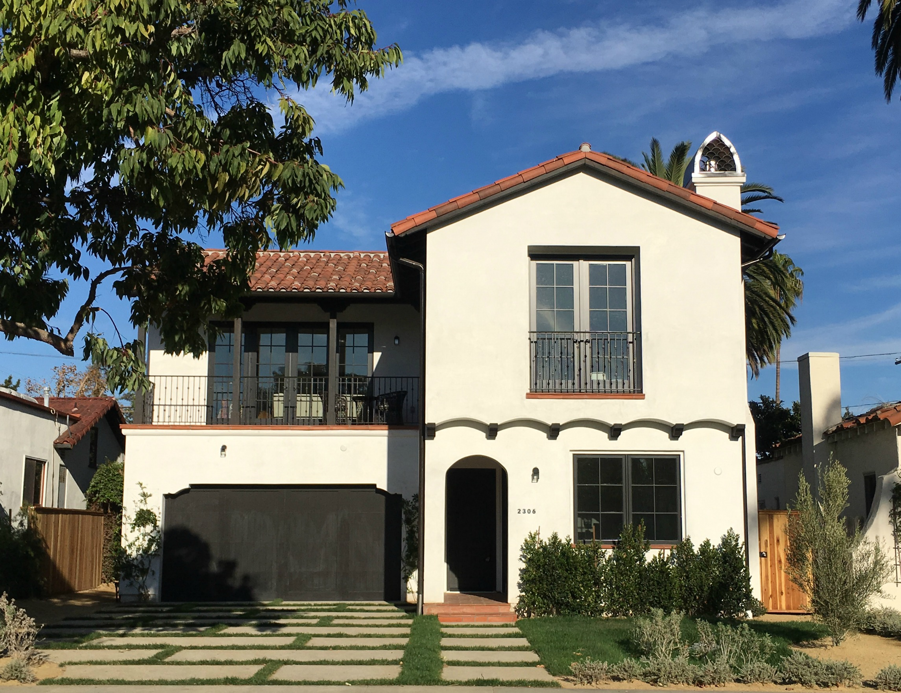
Agenda
Purpose of the Project
Identify the Data Source
Strategy and Metrics
Data Collection
Data Visualization /Analysis
Recommendation
Limitations
Q&A

Slide 3
Purpose of the Project
Purpose:
Building a simple home guide to home buyers on multiple factors associated with house prices in order to make the buyers more informed when they are making buying decisions
Scope:
Buyer profile: first time buyer, school focus buyer (for kids), professional buyer, rich buyer,
Region: LA County
Time: Most Recent data (“less than a year”)

Slide 4
Identify the Data Source
Database/Sources:
Census data: API Census 2016: https://github.com/CommerceDataService/census-wrapper
Google Data: Google API Search: https://developers.google.com/places/
Zillow API (Prices per properties): https://www.zillow.com/webservice/GetSearchResults.htm?
School Ranking Data: Build manually from: http://school-ratings.com/counties/Los_Angeles.html
Crime data https://catalog.data.gov/dataset/crime-data-from-2010-to-present (from: data.lacity.org)

Slide 5
Strategy and Metrics
Strategy:
- Chose only the 10 cities in Los Angeles County with a substantial population for this project.
Look at various metrics (House prices, population, school ranks, HH income, etc) and compare between cities

Slide 6

Data Collection (ZILLOW)
Zillow API requires specific addresses so we used a reverse geocode function to turn coordinates into addresses
After getting addresses, we called the Zillow API to check if a property exists at each address
For valid properties we ran Zillow’s GetDeepSearchResults function to get further information, such as Zestimate, square ft, # of bedrooms and bathrooms, etc.
Did necessary data cleaning and wrote information to CSV

Slide 7
DATA COLLECTION
API Google Search
API Census
Purpose: Get amenities close to selected cities
Challenge: Choose the right “target_type”
Ex. Public transportation: ["light_rail_station","transit_station","subway_station"]
Purpose: Get rates could influence in a buyer for choosing a place to buy a property.
Challenges:
Timeout: Call API several times.
Clean data:
median_age_value = los_angeles_census_df["Median Age"]>-666666666
median_male_age_value = los_angeles_census_df["Median_male_age"]>-666666666
median_female_age_value = los_angeles_census_df["Median_female_age"]>-666666666
age_stats_df = los_angeles_census_df[median_age_value & median_male_age_value & median_female_age_value]
Remove invalid data
New Dataframe with clean data

Slide 8
Data Visualization /Analysis
City House Prices
City Amenities
City Poverty Rate and income Differences
City Education Level
City Walkable Rate

Slide 9
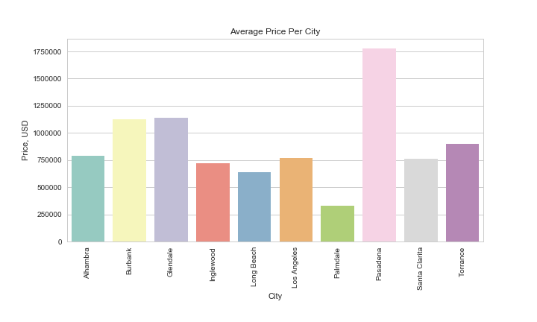
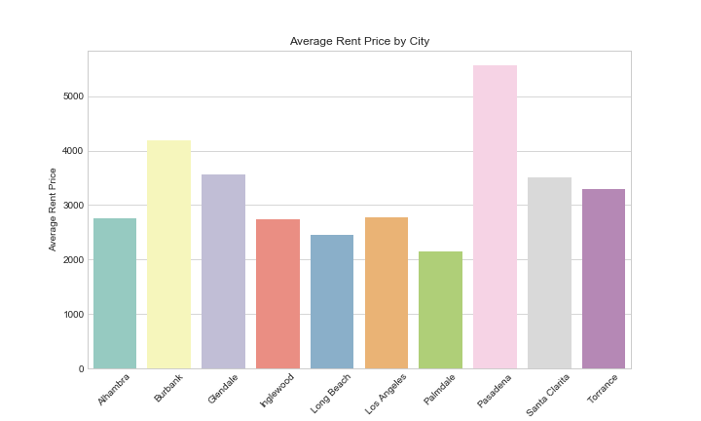
CITY HOUSE PRICES
-Pasadena has the highest property value and rent prices, followed by Burbank
-In Santa Clarita and Torrance, it is actually better to purchase because property value is relatively low whereas renting prices are high

Slide 10
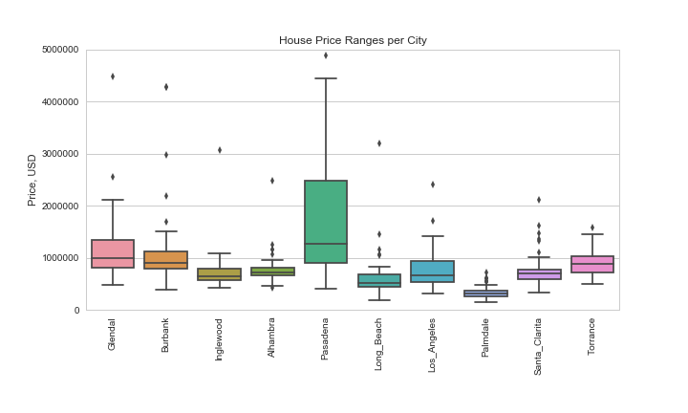
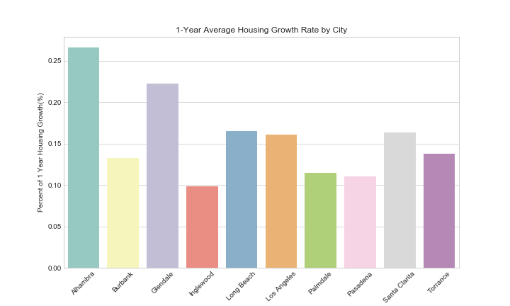
CITY HOUSE PRICES
-Pasadena has the highest house price ranges, followed by Glendale and Burbank, if people really want to live in these neighborhoods they might be able to find some properties that are lower than 1,000,000 USD
-The Alhambra houses have the highest price growth rate for the past year, followed by Glendale.

Slide 11
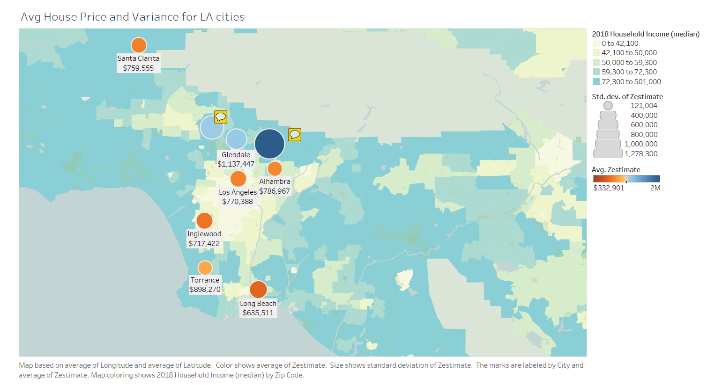
CITY HOUSE PRICES
Burbank
$760,000
Pasadena
$17,779,257

Slide 12
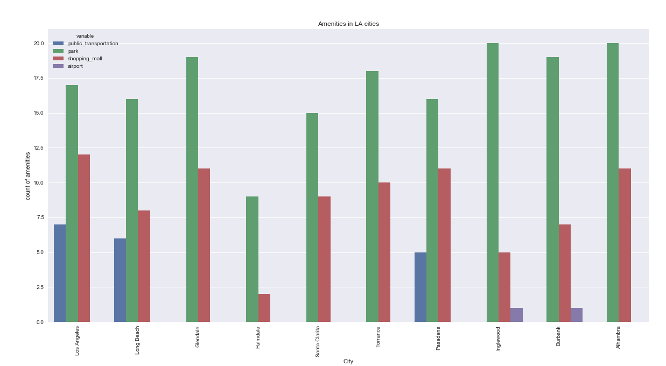
City Amenities
Palmdale has the least amenity compare to other cities
Only LA, Long Beach and Pasadena have public transportation
Inglewood, Burbank and Palmdale have less shopping malls compare to other cities

Slide 13
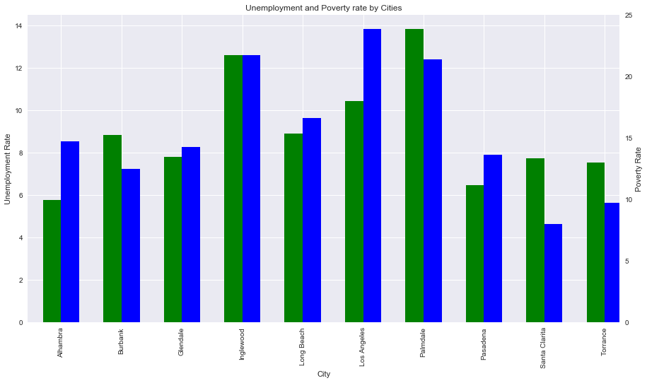
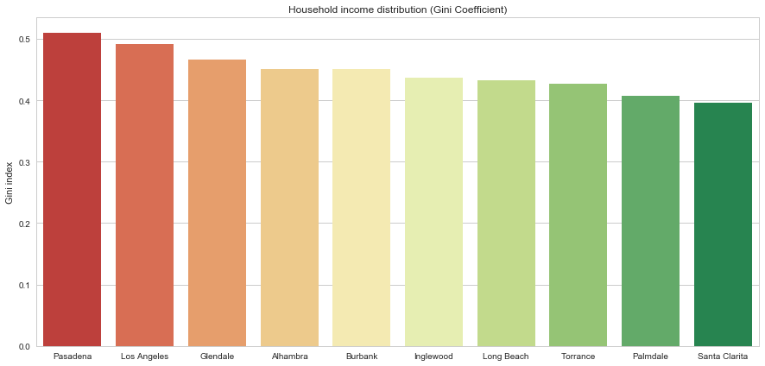
Census API
Poverty/unemployment and household income differences
Analysis of two rates in one graph, different metrics
in axes left (Unemployment rate) and right (Poverty rate)
Gini index: Help to understand household income distribution.
Best value 0… going to green
Worst value 1… going to red
-Palmdale Inglewood and LA have the highest poverty rate and unemployment.
-In terms of the income difference, with Palmdale being the lowest, meaning that most people in Palmdale have the same income, because the poverty rate is very high, it is probably one of the low income neighborhoods.

Slide 14
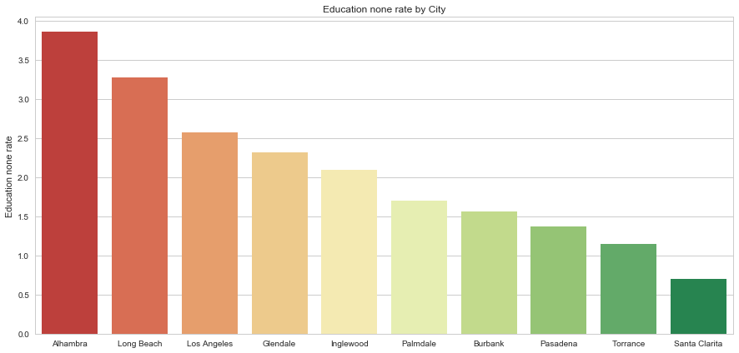
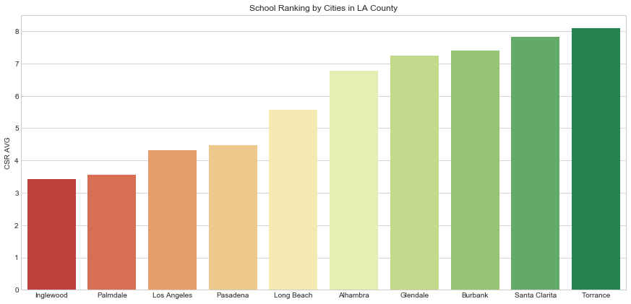
Census API
Education level and school ranking
Rate of persons age 25 and over who are illiterate Best value… going to zero (green)
CSR school ranking average includes: Elementary, middle and high school.
Best value: 10 (green)
-Santa Clarita, Torrance and Pasadena has the highest Education rate and Torrance and Santa Clarita have good schools for Children. They will be good investment places for people with kids that are going to school

Slide 15
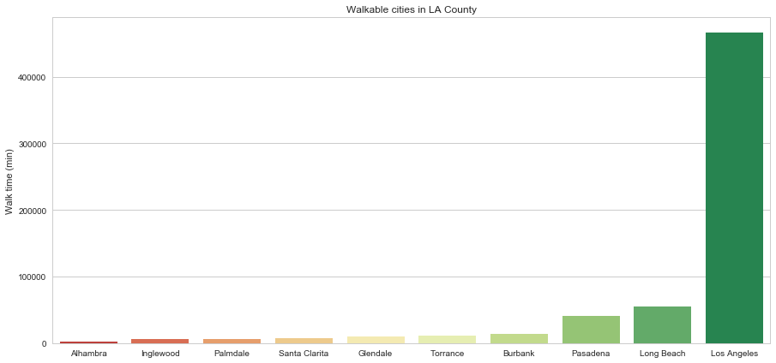
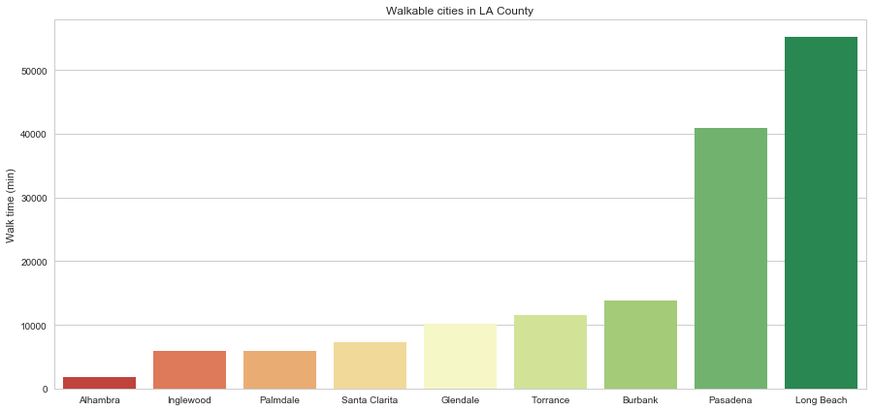
Census API
Walkable Rate
Walkable rate: Time spent commuting (in minutes): walking
LA has a considerable higher rate due to Downtown
Analysis without LA
-LA is the most walkable, following by Long beach and Pasadena, this is highly correlated with the public transportation available. Only LA, Long Beach and Pasadena have public transportation available

Slide 16
Recommendation
First Time Buyer: Torrance / Los Angeles
- Reasonable House Price / Convenient Amenities
Rich Buyer: Pasadena / Glendale / Burbank
- House Price / Airport / Household Income Distribution
School Focus Buyer: Torrance / Santa Clarita / Burbank / Glendale / Alhambra
- Good School Ranking
Professional Buyer: Los Angeles / Long Beach / Pasadena
- Convenient / Career Potential / Higher Average Income / Transportation
Investment Buyer: Pasadena / Burbank / Alhambra / Glendale
- Rent Price / House Price Growth Rate / High House Price Ranges

Slide 17

Limitations
Zillow API requiring an exact address to call the API was a bit troublesome, so we had to figure out some method to generate addresses within a given radius, but it’s imprecise
Some properties had multiple Zestimate (estimate of property’s worth) if it had been sold multiple times, it was difficult to pick the most recent one
Zillow API made it confusing to check whether or not the house is still currently on the market, we went by whether or not it had a Zestimate
Zillow only allows 1000 API calls per day per key, not good for testing loops

Slide 18
Limitations
Not all the attribute was used to help with the recommendation (i.e. Crime Rate)
Limited Sample Data (i.e. 50ish Zillow data per city)

Slide 19
Q&A

